Slide 1

Manufacturing Analytics Project
Dashboards using Excel, Tableau, SQL, and Power BI

Slide 2
Introduction
This project analyzes manufacturing data using multiple platforms:
- Excel
- Tableau
- SQL
- Power BI
Focus: KPI tracking, efficiency analysis, and wastage reduction.

Slide 3
Data Overview
Source: PROD DATA (cleaned)
Key Metrics:
- Manufactured Qty
- Processed Qty
- Rejected Qty
- Wastage Qty (%)

Slide 4
Objectives & KPIs
Objectives:
1. Build dashboards across Excel, Tableau, SQL, and Power BI.
2. Track KPIs:
- Manufacture Qty
- Processed Qty
- Rejected Qty
- Wastage Percentage
3. Provide insights for process optimization and quality control.

Slide 5
Process
Steps followed:
1. Data Cleaning for all tools (Excel, SQL, Tableau, Power BI).
2. KPI Calculations (Manufactured, Processed, Rejected, Wastage).
3. Dashboard Creation.
4. Insights and Recommendations.

Slide 6




Analysis - Key Performance Indicators (KPIs)
The project tracked and analyzed the following KPIs:
Manufacture Quantity – Total units produced
Processed Quantity – Successfully processed units
Rejected Quantity – Units rejected during quality checks
Wastage Quantity – Units wasted due to inefficiencies
Wastage Percentage = (Rejected ÷ Manufactured) × 100

Slide 7
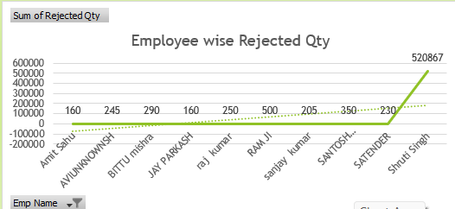
Analysis - Employee-wise Rejected Qty
Chart: Employee vs Rejected Qty
Insights:
- Identifies employees with higher rejection rates.
- Enables targeted training.

Slide 8
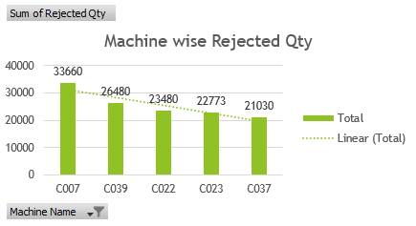
Analysis - Machine-wise Rejected Qty
Chart: Machine vs Rejected Qty
Insights:
- Highlights problematic machines.
- Indicates calibration/maintenance needs.

Slide 9
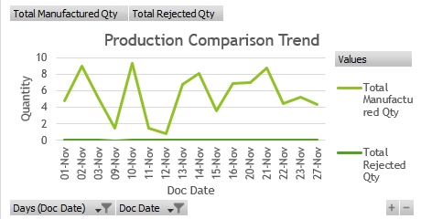
Analysis - Production Comparison Trend
Chart: Trend of Manufactured vs Processed Qty
Insights:
- Reveals efficiency trends over time.
- Supports capacity planning.

Slide 10
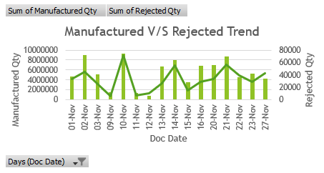
Analysis - Manufacture vs Rejected Qty
Chart: Manufactured vs Rejected Qty
Insights:
- Shows rejection ratio.
- Highlights process inefficiencies.

Slide 11
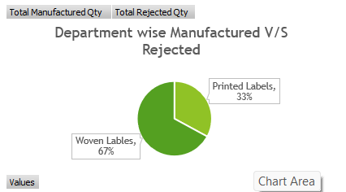
Analysis - Department-wise Manufacture vs Rejected
Chart: Department vs Rejected Qty
Insights:
- Identifies departments with higher rejections.
- Guides improvement efforts.

Slide 12
Recommendations & Insights
Introduce
Introduce mid-process quality checks.
Calibrate
Calibrate high-rejection machines.
Track
Track wastage % in real-time.
Use
Use predictive analytics for risk forecasting.

Slide 13
Conclusion
Project Outcomes:
- Built dashboards in multiple tools.
- Analyzed KPIs effectively.
- Generated actionable recommendations.
TEAM MEMBERS:
- Aswanth MT
- Kaniphnath
- Namratha
- Koushik
- Sunandha

Slide 14
Challenges & Learnings
Challenges:
- Cleaning large datasets.
- Ensuring consistent KPI formulas.
- Handling tool-specific limitations.
Learnings:
- Stronger skills in dashboarding tools.
- Deeper understanding of KPI tracking.
- Effective teamwork in data-driven projects.

Slide 15
